Slide 1

Regulations
Chapter 2(ASP-2, CSP-2)

Slide 2
Learning outcomes
Occupational Safety and Health Act
Horizontal and Vertical Standards
Communications and Correspondence with OSHA
OSHA Inspections and Process
OSHA Citation Penalties
OSHA Appeals
Hazard Communication Standard (29 CFR 1910.1200)
Blood-Borne Pathogens Standard (29 CFR 1910.1030)
Control of Hazardous Energy Standard (29 CFR 1910.147)
Confined Space Entry Standard (29 CFR 1910.146)
Personal Protective Equipment (29 CFR 1910.132)
Respiratory Protection Standard (29 CFR 1910.134)
Fall Protection Standard (29 CFR 1926.500–503) (Subpart M)
Reporting Serious Incidents or Fatalities (29 CFR 1904.39)
Calculating Total Recordable Incident Rates (TRIR)

Slide 3
Occupational Safety and Health Act
Referred to as the Williams–Steiger Occupational Safety and Health Act of 1970.
The Occupational Safety and Health Administration (OSHA) was created within the Department of Labor.
Encourage employers and employees to reduce workplace hazards and to implement new or improve existing safety and health standards
Establish “separate but dependent responsibilities and rights” for employers and employees for the achievement of better safety and health conditions;
Maintain a reporting and record-keeping system to monitor job-related injuries and illnesses; establish training programs to increase the number of competent occupational safety and health personnel;
Develop mandatory job safety and health standards, and enforce them effectively.
All private sector employers with one or more workers in all 50 states and U.S. territories are governed under the OSH Act
OSHA regulations do not apply to public sector (municipal, county, state, or federal government agencies), self-employed individuals, family members operating a farm, or domestic household workers.

Slide 4
Horizontal and Vertical Standards
Horizontal standards are those standards that apply to all industries and employers. For example, fire prevention and protection standards are horizontal standards.
Vertical standards are those standards that apply only to particular industries and employers. Standards that apply only to the construction industry like scaffolding, power-operated tools, life-saving equipment, signs, barricades

Slide 5
General Duty Clause
General Duty Clause states that an employer shall furnish
“a place of employment which is free from recognized hazards that are causing or are likely to cause death or serious physical harm to its employees.”

Slide 6
Employer Rights and Responsibilities
Examine workplace conditions
Minimize or reduce hazards
Use color codes, poster, labels, or signs warn about hazards
Provide training
Keep OSHA-required records
Access to medical records and exposure records.

Slide 7
Employee Rights and Responsibilities
Employees should
Read the OSHA poster.
Follow the safety rules
Follow safe work practices.
Report hazardous conditions to a supervisor
Report hazardous conditions to OSHA
Expect safety and health on the job without fear of reprisal.

Slide 8
Communications and Correspondence with OSHA
There are two trains of thought among safety professionals when communicating and dealing with OSHA.
The first train of thought is the belief that OSHA is the enemy and any communication or correspondence with them will result in a negative way for the company.
The second thought is that OSHA has a purpose to protect the health and safety of employees and also serve as a valuable resource and partner for American businesses.
The safety professional must remember that a large portion of OSHA’s responsibility lies in enforcing the regulations.
Information provided to them can be used to levy penalties against your organization.
When confronted on an official basis with a potential citation or penalty, it is best to provide only those specific documents that are requested.

Slide 9
OSHA Inspections
Whenever an OSHA inspection occurs, the employer must
Be advised by the compliance officer of the reason for the inspection,
Require identification of the OSHA compliance officer,
Accompany the compliance officer on the inspection,
Be assured of the confidentiality of any trade secrets observed by an OSHA compliance officer during an inspection.
Inspections are based on the following priorities:
Imminent danger situations
Catastrophes and fatal accidents
Employee complaints
Programmed high-hazard inspections
Follow-up inspections

Slide 10
OSHA Inspections Process
Compliance officer will prepare himself to get familiar with the potential hazards and processes involved.
Compliance officer begins by presenting his credentials.
Compliance officer has the right, under the law, for timely admission to the facility, delay or refusal of admittance trigger to obtain a warrant.
Compliance officer will hold an opening conference, explain the purpose of the visit.
How your particular facility was selected and scope of the inspection.
Compliance officer will ask for employer representative and conducts a walkthrough and may review records, collect air samples, measure noise readings, or photograph and videotape.
Then in closing conference, he discusses with the employer all unsafe or unhealthful conditions and indicate the violations for which he may recommend a citation and a proposed penalty.
Compliance officer will also inform the employer of the appeal process.

Slide 11
OSHA Citations
Compliance officer files his report with the Area Director.
Area Director, determines whether he will issue a citation or propose penalties.
Area Director will send all citations via certified mail.
Once the employer has received the citation, they must post the citation for 3 days or until the violation has been abated, whichever is longer.

Slide 12
OSHA Citation Penalties
Other-than-serious violation: A violation that would not cause death or serious physical harm. OSHA may assess a penalty from $0 to $13,206 for each violation. The agency may adjust a penalty for an other-than-serious violation downward by as much as 95%.
Serious violation: Substantial probability that death or serious physical harm could result from $947 to $13,206 for each violation.
Willful violation: Intentionally and knowingly commits, OSHA may propose penalties from $9,472 to $132,598 for each willful violation.
Repeated violation: $9,472 to $132,598 for each repeated violation.
Failure to abate violation: $13,260 for each day that the violation continues beyond the prescribed abatement date.

Slide 13
Additional violations
Falsifying records, reports, or applications can, upon conviction, bring a criminal fine of $10,000 or up to 6 months in jail, or both;
Violating posting requirements may bring a civil penalty of $7,000;
Assaulting a compliance officer or otherwise resisting, opposing, intimidating, or interfering with a compliance officer in the performance of his or her duties is a criminal offense and is subject to a fine of not more than $5,000 and imprisonment for not more than 3 years.
Note 1: Citations and penalty procedures may differ slightly in states with their own occupational safety and health programs.
Note 2: Department of Labor is required to adjust minimum OSHA penalties for inflation by January 15 of each New Year.

Slide 14
Appeals
Employee Appeals:
If an employee complaint initiates an inspection, the employee or authorized employee representative may request an informal review of any decision not to issue a citation.
They also may request an employer’s “Petition for Modification of Abatement,” which requests an extension of the proposed abatement period.
Employees must contest the petition within 10 working days of its posting or within 10 working days after an authorized employee receives a copy.
Employer Appeals:
Within 15 working days of receiving a citation, OSHA Area Director forwards the objection to the Occupational Safety and Health Review Commission (OSHRC).
The OSHRC is a commission of three member administrative law judges appointed by the President of the United States, with the consent of congress.
Each judge appointed serves a term of 6 years.
Initial appointments were 2 years for the first judge, 4 years for the second judge, and 6 years for the third judge.
This provides some administrative consistency within the commission.
An employer may request an informal meeting with OSHA’s Area Director to discuss the case.
OSHA encourages employers to have informal conferences with the Area Director to discuss or provide additional information.
The Area Director is authorized to enter into settlement agreements that revise citations and penalties to avoid prolonged legal disputes and result in speedier hazard abatement.

Slide 15
Notice of Contest
If the employer decides to contest either the citation, the abatement period, or the proposed penalty, he has 15 working days.
Failure to do so results in the citation and proposed penalty becoming a final order of the OSHRC without further appeal.
An orally expressed disagreement will not suffice. This written notification is called a “Notice of Contest.”

Slide 16
Review Procedure
OSHRC commission assigns the case to an administrative law judge.
OSHRC may schedule a hearing at a public place near the employer’s workplace.
The employer and the employee have the right to participate in the hearing; the OSHRC does not require them to be represented by attorneys.
Once the administrative law judge has ruled, any party to the case may request a further review by OSHRC.
Employers and other parties may appeal commission ruling to the appropriate U.S. Court of Appeals.
States with their own occupational safety and health programs have a state system for review and appeal of citations, penalties, and abatement periods.

Slide 17
Hazard Communication Standard(HCS)
(29 C FR 1910.1200)
Note: This standard has undergone tremendous changes since the initial publication of this book. Therefore, at the end of this chapter, I have elected to republish OSHA’s Comparison of Hazard Communication Requirements between OSHA Hazard Communication Standard 29 CFR 1910.1200 (HCS) and Globally Harmonized System (GHS).

Slide 18
Purpose of HCS
Unofficially known as GHS.
Purpose: Ensure that the hazards of all chemicals produced or imported are classified and that information concerning the classified hazards is transmitted to employers and employees.
Intended to be consistent with the provisions of the United Nations Globally Harmonized System of Classification and Labeling of Chemicals (GHS), Revision 3.
The transmittal of information is to be accomplished by means of comprehensive hazard communication programs, which are to include container labeling and other forms of warning, safety data sheets (SDSs), and employee training.

Slide 19
Scope and Application
Requires chemical manufacturers or importers to classify the hazards of chemicals that they produce or import and all employers to provide information to their employees about the hazardous chemicals to which they are exposed, by means of a hazard communication program.
This standard applies to any chemical that is known to be present in the workplace in such a manner that employees may be exposed under normal conditions of use or in a foreseeable emergency.

Slide 20
Written Hazard Communication Standard
A list of the hazardous chemicals known to be present using a product identifier that is referenced on the appropriate SDS.
The methods the employer will use to inform employees of the hazards of nonroutine tasks.
Multiemployer workplaces. Employers who produce, use, or store hazardous chemicals at a workplace in such a way that the employees of other employers may be exposed shall additionally ensure that the hazard communication programs developed and implemented are transmitted.

Slide 21
Label and Other Forms of Warning
label, tag, or mark must have the following information:
Product identifier.
Signal word.
Hazard statement(s).
Pictogram(s).
Precautionary statement(s).
Name, address, and telephone number of the chemical manufacturer or other responsible party.

Slide 22
Safety Data Sheets
Chemical manufacturers and importers shall obtain or develop an SDS for each hazardous chemical they produce or import.
Employers shall have an SDS in the workplace for each hazardous chemical that they use.
Ensure that it is in English (although the employer may maintain copies in other languages as well) and includes all 16- section.
(See Appendix D to 29 CFR 1910.1200—Safety Data Sheets.

Slide 23
Blood-Borne Pathogens Standard (29 CFR 1910.1030)
Applies to all occupation exposure to blood or other potentially infectious materials present in the work-place.
Blood-borne pathogens means pathogenic microorganisms that are present in human blood and cause disease in humans. These pathogens include, but are not limited to, hepatitis B virus (HBV) and human immunodeficiency virus (HIV).
Potentially infectious materials: semen, vaginal secretions, cerebrospinal fluid, synovial fluid, pleural fluid, pericardial fluid, peritoneal fluid, amniotic fluid, saliva in dental procedures, any body fluid that is visibly contaminated with blood, and all body fluids in situations where it is difficult or impossible to differentiate between body fluids or any unfixed tissue or organ from a human.

Slide 24
Exposure Control Plan
The exposure determination;
The schedule and method of implementation for methods of compliance, HIV and HBV research laboratories and production facilities, hepatitis B vaccination and postexposure evaluation and follow-up, communication of hazards to employees, and record keeping.
The Exposure Control Plan shall be reviewed and updated at least annually.

Slide 25
Hepatitis B Vaccination and Postexposure Follow-Up
If an employee refuse to take the hepatitis B vaccine, the employer is required to obtain a written statement of his or her refusal.
Labels and signs shall be affixed to containers of regulated waste; refrigerators and freezers containing blood or other potentially infectious materials; and other containers used to store, transport, or ship blood or other potentially infectious materials.
The employer shall establish and maintain an accurate record for each employee with occupational exposure.
A copy of the employee’s hepatitis B vaccination status, including the dates of all the hepatitis B vaccinations and any medical records relative to the employee’s ability to receive vaccination.
The employer shall maintain the records required under this standard for at least the duration of employment plus 30 years.
Training records shall be maintained for 3 years from the date on which the training occurred.

Slide 26
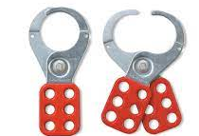
Control of Hazardous Energy Standard
(29 C FR 1910.147)
Implement where, unexpected energization or start-up of the machines or equipment or the release of stored energy could cause injury to employees.
This standard applies to the control of energy during servicing or maintenance of machines and equipment.
Affected employee. An employee whose job requires him or her to operate or use a machine or equipment on which servicing or maintenance is being performed under lockout or tagout.
Authorized employee. A person who locks or tags out machines
Capable of being locked out. An energy-isolating device capable of being locked out if it has a hasp(lock) or other means of attachment to which a lock can be affixed or it has a locking mechanism built into it.

Slide 27
Hot tap. A hot work for maintenance of installation like welding.
Lockout: Ensuring that the energy-isolating device and the equipment being controlled cannot be operated until the lockout device is removed.
Lockout device: A device that utilizes a positive means, such as a lock, either key or combination type, to hold an energy-isolating device in a safe position and prevent the energizing of a machine or equipment.
Normal production operations: The utilization of a machine or equipment to perform its intended production function.
Servicing or maintenance: constructing, installing, setting up, adjusting, inspecting, modifying, and maintaining or servicing machines or equipment.
Setting up: To prepare a machine or equipment to perform its normal operation.
Tagout: Place to indicate that the energy-isolating device and the equipment being controlled may not be operated until the tagout device is removed.
Tagout device. To indicate that the energy-isolating device and the equipment being controlled may not be operated until the tagout device is removed.

Slide 28
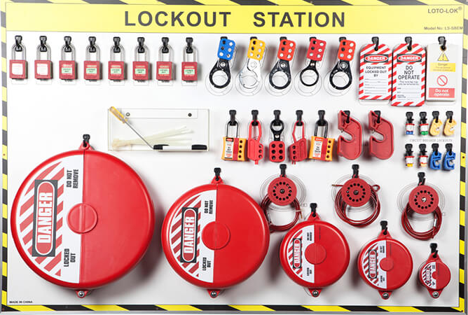
Energized. Connected to an energy source or containing a residual energy.
Energy-isolating device. A mechanical device that physically prevents the transmission or release of energy, including circuit breaker, disconnect switch; a line valve; a block, Push buttons, selector switches, and other.
Energy source. Electrical, mechanical, hydraulic, pneumatic, chemical, thermal, or other energy.

Slide 29
Periodic Inspection
The employer shall conduct a periodic inspection of the energy control procedure at least annually to ensure that the procedure and the requirements of this standard are being followed.
The periodic inspection shall be performed by an authorized employee other than the one(s) utilizing the energy control procedure being inspected.
The periodic inspection shall be conducted to correct any deviations or inadequacies identified.
The employer shall certify that the periodic inspections have been performed.
The certification shall identify the machine or equipment on which the energy control procedure was being utilized, the date of the inspection, the employees included in the inspection, and the person performing the inspection.

Slide 30
Training and Communication
To ensure that the purpose and function of the energy control program.
Recognition of applicable hazardous energy sources, the type and magnitude of the energy available in the workplace, and the methods and means necessary for energy isolation and control;
Purpose and use of the energy control procedure.
Prohibition relating to attempts to restart or reenergize machines or pieces of equipment that are locked or tagged out.
Retraining whenever there is a change in job, machines, equipment, or processes that present a new hazard, or when change in the energy control procedures.

Slide 31
Confined Space Entry Standard (29 C FR 1910.146)
Scope and Application
This standard contains requirements for practices and procedures to protect employees in general industry from the hazards of entry into permit-required confined spaces. This standard does not apply to agriculture, construction, or shipyard employment.
Definitions
Acceptable entry conditions means the conditions that must exist in a permit space to allow entry and to ensure that employees involved with a permit-required confined space entry can safely enter into and work within the space.
Attendant means an individual stationed outside one or more permit spaces who monitors the authorized entrants and who performs all attendant’s duties assigned in the employer’s permit space program.
Authorized entrant means an employee who is authorized by the employer to enter a permit space.
Confined space means a space that (1) is large enough and so configured that an employee can bodily enter and perform assigned work, (2) has limited or restricted means for entry or exit, and (3) is not designed for continuous employee occupancy.

Slide 32
Engulfment means the surrounding and effective capture of a person by a liquid or finely divided (flowable) solid substance that can be aspirated to cause death by filling or plugging the respiratory system or that can exert enough force on the body to cause death by strangulation, constriction, or crushing.
Entry means the action by which a person passes through an opening into a permit-required confined space.
Entry permit means the written or printed document that is provided by the employer to allow and control entry into a permit space and that contains the information required in the standard.
Entry supervisor means the person responsible for determining if accept-able entry conditions are present at a permit space where entry is planned, for authorizing entry and overseeing entry operations, and for terminating entry as required in the standard.
Hazardous atmosphere means an atmosphere that may expose employees to the risk of death, incapacitation, impairment of ability to self-rescue, injury, or acute illness.
Immediately dangerous to life or health means any condition that poses an immediate or delayed threat to life or that would cause irreversible adverse health effects or that would interfere with an individual’s ability to escape unaided from a permit space.

Slide 33
Isolation means the process by which a permit space is removed from service and completely protected against the release of energy and material into the space.
Oxygen-deficient atmosphere means an atmosphere containing less than 19.5% oxygen by volume.
Oxygen-enriched atmosphere means an atmosphere containing more than 23.5% oxygen by volume.
Permit-required confined space means a confined space that has one or more of the following characteristics:
Contains or has a potential to contain a hazardous atmosphere.
Contains a material that has the potential for engulfing an entrant.
Has an internal configuration such that an entrant could be trapped or asphyxiated by inwardly converging walls or by a floor that slopes downward and tapers to a smaller cross section.
Contains any other recognized serious safety or health hazard.
Rescue service means the personnel designated to rescue employees from permit spaces.

Slide 34
General Requirements
The employer shall evaluate the workplace to determine if any spaces are permit-required confined spaces. If the workplace contains permit spaces, the employer shall inform exposed employees by posting danger signs, or by any other equally effective means, of the existence and location of and the danger posed by the permit spaces.

Slide 35
Confined Space Entry Program
If the employer decides that its employees will enter permit spaces, the employer shall develop and implement a written permit space program that complies with this standard. The written program shall be available for inspection by employees and their authorized representatives.
Under the confined space entry program, the employer shall
  Implement the measures necessary to prevent unauthorized entry;
  Identify and evaluate the hazards of permit spaces before the employee enters them;
  Develop and implement the means, procedures, and practices necessary for safe permit space entry operations.

Slide 36
Entry Permits
The entry permit that documents compliance with this standard and authorizes entry to a permit space shall include the following:
  The permit space to be entered,
  Purpose of the entry,
  Date and the authorized duration of the entry permit,
  Authorized entrants by name,
  Attendant name,
  Entry supervisor (by name),
  Measures to isolate the permit space and to eliminate or control permit space hazards before entry.
Employees must have the opportunity to observe the monitoring under this standard.

Slide 37
Training
The employer shall provide training so that all employees whose work is regulated by this standard acquire the understanding, knowledge, and skills necessary for the safe performance of their duties.
Training shall be provided to each affected employee before the employee is first assigned duties under this standard.
Whenever there is a change in assigned duties, the employer determines that there is a discrepancy in the program, or there is a change in permit space operations that present a hazard about which an employee has not previously been trained, and thus, additional training is required.
The employer shall certify that the training required has been accomplished. The certification shall contain each employee’s name, the signatures or initial of the trainers, and the dates of training.
The certification shall be available for inspection by employees and their authorized representatives.

Slide 38

Personal Protective Equipment (29 CFR 1910.132)
Application
Protective equipment covered in this standard includes personal protective equipment (PPE) for eyes, face, head, and extremities; protective clothing; respiratory devices; and protective shield and barriers, which shall be provided, used, and maintained in a sanitary and reliable condition wherever it is necessary by reason of hazards of processes or environment, chemical hazards, radiological hazards, or mechanical irritants encountered in a manner capable of causing injury or impairment in the function of any part of the body through absorption, inhalation, or physical contact.
Note: OSHA’s Final PPE Rule, which was effective on February 13, 2008, requires employers to provide PPE, at no cost to the employees. The Final Rule does not require an employer to provide normal safety boots or shoes, but does require the employer to provide specialty boots.

Slide 39
Employee-Owned Equipment
Where employees provide their own protective equipment (of their own choice), the employer shall be responsible to assure its adequacy, including proper maintenance and sanitation of such equipment.

Slide 40
Hazard Assessment and Equipment Selection
The employer shall assess the workplace to determine if hazards are present, or are likely to be present, which necessitate the use of PPE. If such hazards are present, or likely to be present, the employer shall
Select and have each affected employee use the types of PPE that will protect the affected employee from the hazards identified in the hazard assessment,
Communicate selection decisions to each affected employee
Select PPE that properly fits each affected employee. The employer shall verify that the required workplace hazard assessment has been performed through a written certification that identifies the workplace evaluated; the person certifying that the evaluation has been performed; the date(s) of the hazard assessment; and which determines the document as a certification of the hazard assessment.

Slide 41
Training
Each employee shall be trained to know at least the following:
When PPE is necessary.
What PPE is necessary.
How to properly don, doff, adjust, and wear PPE.
Limitations of the PPE.
Proper care, maintenance and useful life, and disposal of the PPE.
Each affected employee shall demonstrate an understanding of the training and the ability to use PPE properly, before being allowed to perform work requiring the use of PPE.
When the employer has reason to believe that any affected employee who has already been trained does not have the under-standing and skill required, the employer shall retrain each such employee.

Slide 42
Respiratory Protection Standard (29 CFR 1910.134)
The purpose of the Respiratory Protection Standard is to control those occupational diseases caused by breathing air contaminated with h armful dusts, fogs, fumes, mists, gases, smokes, sprays, or vapors.
This shall be accomplished as far as feasible by accepted engineering control measures.
When effective engineering control measures are not feasible, or while they are being instituted, appropriate respirators shall be used.
Respirators shall be provided by the employer when such equipment is necessary to protect the health of the employee.
The employer shall provide the respirators that are applicable and suitable for the purpose intended.
The employer shall be responsible for the establishment and maintenance of a respiratory protection program, which shall include the requirements of this standard.

Slide 43
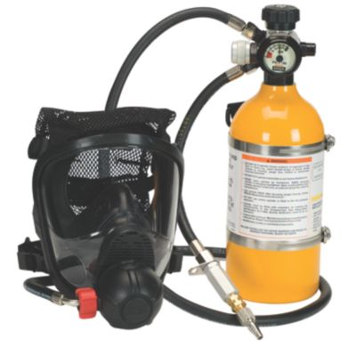
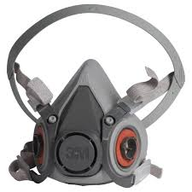
Definitions
Air-purifying respirator means a respirator with an air-purifying filter, cartridge, or canister that removes specific air contaminants by passing ambient air through the air-purifying element.
Assigned protection factor means the protection factor assigned to the respirator type.
Atmosphere-supplying respirator means a respirator that supplies the respirator user with breathing air from a source independent of the ambient atmosphere and includes supplied-air respirators and self-contained breathing apparatus units.
Fit test means the use of a protocol to qualitatively or quantitatively evaluate the fit of a respirator on an individual.

Slide 44
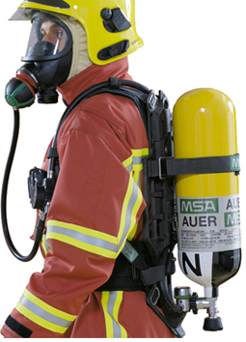
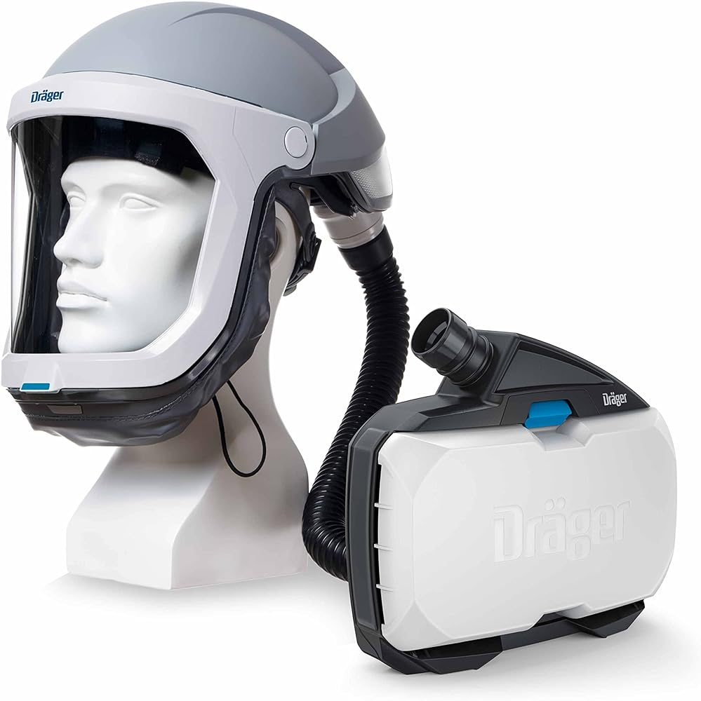
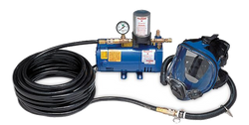
Definitions
Powered air-purifying respirator means an air-purifying respirator that uses a blower to force the ambient air through air-purifying elements to the inlet covering.
Qualitative fit test means a pass/fail test to assess the adequacy of respirator fit that relies on the individual’s response to the test agent.
Quantitative fit test means an assessment of the adequacy of respirator fit by numerically measuring the amount of leakage into the respirator.
Self-contained breathing apparatus means an atmosphere-supplying respirator for which the breathing air source is designed to be carried by the user.
Supplied-air respirator or airline respirator means an atmosphere- supplying respirator for which the source of breathing air is not designed to be carried by the user.

Slide 45
Respiratory Protection Program
The employer shall include in the written program the following information:
  Procedures for selecting respirators for use in the workplace.
  Medical evaluations of employees required to use respirators.
  Fit testing procedures.
  Procedures for proper use of respirators.
  Procedures and schedules for cleaning, disinfecting, storing, inspecting, repairing, discarding, and otherwise maintaining respirators.
  Procedures to ensure adequate air quality, quantity, and flow of breathing air for atmosphere-supplying respirators.
  Training required for respirator usage.
  Procedures for evaluating the effectiveness of the program.

Slide 46

Training and Information
The training must be comprehensive, must be understandable, and must recur annually, and more often, if necessary.
Training must ensure that each employee can demonstrate knowledge and understanding of the topic, and include the following:
  Why respirator protection is necessary and how improper wearing or use can compromise the protection received;
  Limitations and capabilities of the respirator and cartridge (filter);
  Inspection and maintenance procedures;
  Cleaning, disinfecting, and storage procedures;
  Proper wear of the respirator.
Retraining shall be administered annually, or when a new process or procedure is implemented that the employee has not been previously trained.

Slide 47
Fall Protection Standard
(29 CFR 1926.500–503) (Subpart M)
This standard sets forth the requirements and criteria for fall protection in construction work areas covered by this standard.
Exception: The provisions of this standard do not apply when employees are making inspection, investigation, or assessment of workplace conditions prior to the actual start of construction work or after all construction work has been completed.

Slide 48
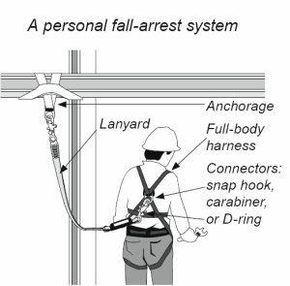
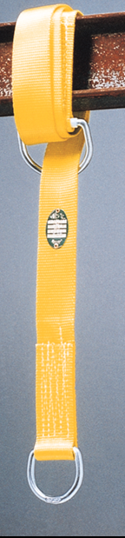
Definitions
Anchorage means a secure point of attachment for lifelines, lanyards, or deceleration devices. Anchorage points must be rated to 5,000 lb per person attached.
Body harness means straps that may be secured about the employee in a manner that will distribute the fall arrest forces over at least the thighs, pelvis, waist, chest, and shoulders with means for attaching it to other components of a personal fall arrest system.
Connector means a device that is used to couple parts of the personal fall arrest system and positioning device systems together.
Controlled access zone means an area in which certain work may take place without the use of guardrail systems, personal fall arrest systems, or safety net systems and access to the zone is controlled.

Slide 49
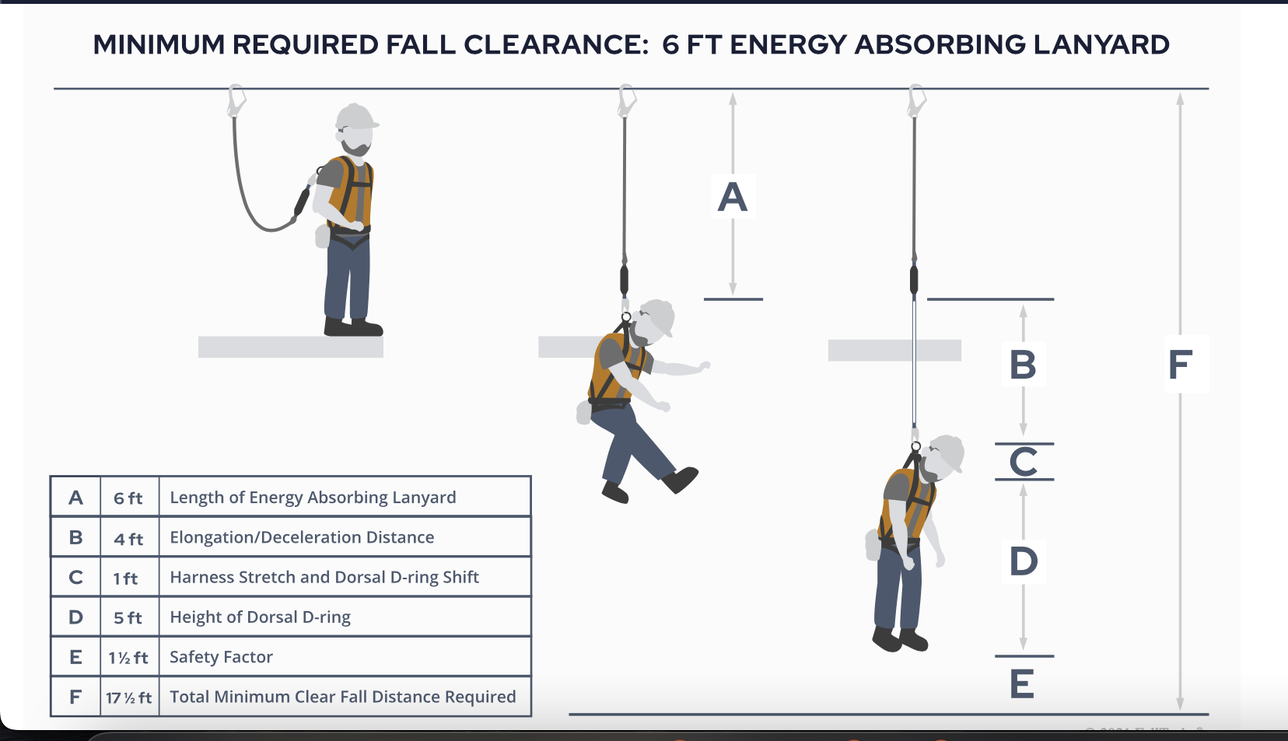
Definitions
Deceleration device means any mechanism, such as a rope grab, rip-stitch lanyard, specially woven lanyard, tearing or deforming lanyards, and automatic self-retracting lifelines/lanyards, that serves to dissi-pate a substantial amount of energy during a fall arrest, or otherwise limit the energy imposed on an employee during a fall arrest.
Deceleration distance means the additional vertical distance a falling employee travels, excluding lifeline elongation and free fall distance, before stopping, from the point at which the deceleration device begins to operate.
Free fall means the act of falling before a personal fall arrest system begins to apply force to arrest the fall.

Slide 50
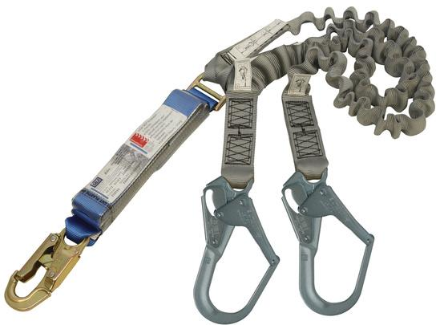
Definitions
Guardrail system means a barrier erected to prevent employees from falling to lower levels.
Lanyard means a flexible line of rope, wire rope, or strap that generally has a connector at each end for connecting the body harness to a deceleration device, lifeline, or anchorage.
Leading edge means the edge of a floor, roof, or formwork for a floor or other walking/working surface that changes location as additional floor, roof, decking, or formwork sections are placed, formed, or constructed. A leading edge is considered to be an “unprotected side and edge” during periods when it is not actively and continuously under construction.

Slide 51
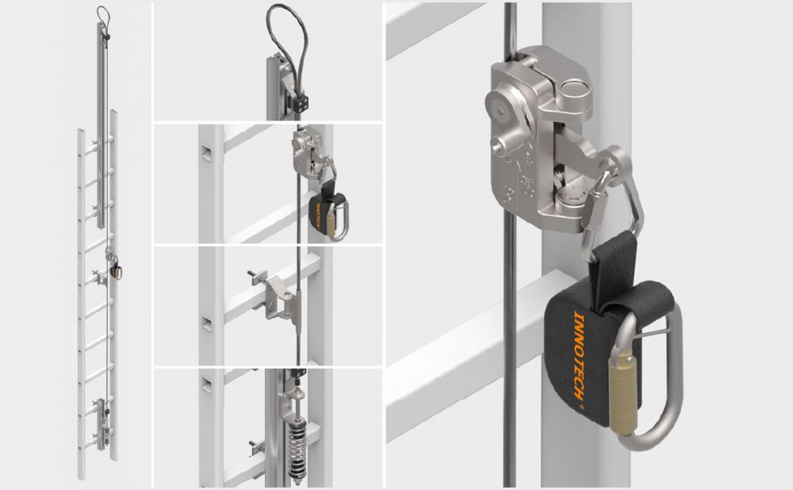
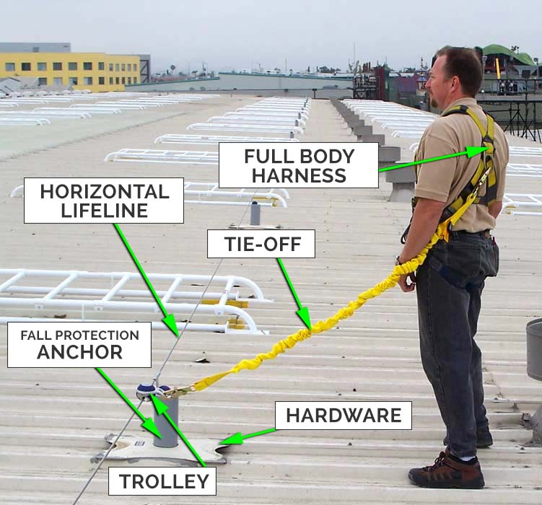
Definitions
Lifeline means a component consisting of a flexible line for connection to an anchorage at one end to hang vertically (vertical lifeline), or for connection to anchorages at both ends to stretch horizontally (horizontal lifeline), and which serves as a means for connecting other components of a personal fall arrest system to the anchorage.
Personal fall arrest system means a system used to arrest an employee in a fall from a working level. It consists of an anchorage, connectors, and body harness and may include a lanyard, deceleration device, lifeline, or suitable combinations of these.
Walking/working surface means any surface, whether horizontal or vertical, on which an employee walks or works, including, but not limited to, floors, roofs, ramps, bridges, runways, formwork, and concrete reinforcing steel, but not including ladders, vehicles, or trailers, on which employees must be located in order to perform their duties.

Slide 52
Duty to Have Fall Protection
The employer shall determine if the walking/working surfaces on which its employees are to work have the strength and structural integrity to support employees safely.
Employees shall be allowed to work on those surfaces only when the surfaces have the requisite strength and structural integrity.
Each employee on a walking/working surface (horizontal and vertical sur-face) with an unprotected side or edge which is 6 ft or more above a lower level shall be protected from falling by the use of guardrail systems, safety net systems, or personal fall arrest system.

Slide 53
Training
The employer shall assure that each employee has been trained, as necessary, by a competent person qualified to teach the following information:
Nature of fall hazards in the work area.
Correct procedures for erecting, maintaining, disassembling, and inspecting fall protection systems to be used.
Use and operation of guardrail systems, personal fall arrest systems, safety net systems, warning line systems, safety monitoring systems, controlled access zones, and other protection to be used.
The role of each employee in the safety monitoring system in which this system is used.
The limitations on the use of mechanical equipment during the performance of roofing work on low-sloped roofs.
Correct procedures for the handling and storage of equipment and materials and the erection of overhead protection.
The role of employers in fall protection plans.
The employer shall verify compliance with the standard by preparing a written certification record.

Slide 54
Record Keeping
OSHA 300, 300 -A, AND 301 FORMS (29 CFR 1904.29)
Employers must use OSHA 300, 300-A, and 301 forms, or equivalent forms, for recordable injuries and illnesses.
The OSHA 300 form is called the Log of Work-Related Injuries and Illnesses.
OSHA 300-A form is the Summary of Work-Related Injuries and Illnesses.
OSHA 301 form is called the Injury and Illness Incident Report.

Slide 55
Record Keeping
How Quickly Must Each Injury or Illness Be Recorded?
An employer must enter each recordable injury or illness on the 300 and 301 incident report with seven calendar days of receiving information that a recordable injury or illness has occurred.
How are “privacy cases” listed on the forms?
The following cases are considered to be privacy cases, and therefore, the employee’s name is not entered on the OSHA 300 form. Instead, enter “PRIVACY CASE” in place of the employee’s name.
An injury or illness to an intimate body part or the reproductive system.
An injury or illness resulting from a sexual assault.
Mental illnesses.
HIV infection, hepatitis, or tuberculosis.
Needlestick injuries and cuts from sharp objects that are contaminated with another person’s blood or other potentially infectious materials.
Other illnesses if the employee voluntarily requests that his or her name not be entered on the log.

Slide 56

Record Keeping
Annual Summary
An annual summary is created on the OSHA 300 log and is certified by a company owner or designated representative.
The OSHA 300-A form is signed by a company owner or designated representative and posted in a conspicuous location no later than February 1 of the year following the year covered by the records.
The OSHA 300-A form shall remain posted until April 30th of the year following the year covered by the records.
OSHA 300 logs (and separate privacy case files, if required) shall be maintained for a period of 5 years following the end of the calendar year that these records cover.

Slide 57
Record Keeping
Providing Records to Government Representatives
When an authorized government representative asks for the records you keep under 1904, you must provide copies of the records within four business hours.
Authorized government representatives under this standard include
A representative of the Secretary of Labor.
A representative of the Secretary of Health and Human Services.
A representative of a state agency responsible for administering a state plan approved under the Act.

Slide 58
Reporting Serious Incidents or Fatalities
(29 CFR 1904.39)
OSHA requires an employer to notify them within eight h after the death of any employee from a work-related incident.
OSHA also requires that employer report hospitalizations, amputations or loss of an eye of employees with 24 h.
This reporting must be orally by telephone or in person to the Area Office of the OSHA nearest the location of the incident.
The toll free number to report this is 1-800-321-6742.
The incident may also report any of these via electronic submissions at www.osha.gov.
One exception to this is a fatality or hospitalizations resulting from a motor vehicle accident occurring on a public road. These do not have to be reported.
However, if the fatality, in-patient hospitalization, amputation, or loss of eye occurred in a construction work zone, you must report the incident to OSHA.

Slide 59

Determining Recordable Injuries or Illnesses
In general, an employer must consider an injury or illness to be recordable, if it results in any of the following:
  Death.
  Days away from work.
  Restricted work or transfer to another job.
  Medical treatment beyond first aid.
  Loss of consciousness.
  Injury or illness diagnosed by a physician or other licensed health care professional.
Note: Determining whether an injury or illness is work related may appear simple on the surface. However, this is not always the case. In the case where an employer believes that the injury or illness is personal and not work related, he or she must record the injury or illness on the OSHA 300 and 300 forms, until such time as it is definitively determined to be nonwork related.

Slide 60

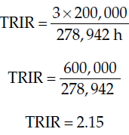
Calculating Total Recordable Incident Rates (TRIR)
Use the following equation:
Example: A company has two recordable injury cases and 1 day away or restricted case for a total of three cases. The company has worked a total of 278,942 h for the year. Calculate the TRIR for this company.
The constant of 200,000 is based on 100 employees working 2,000 h/year. Therefore, this rate is stating that for every 100 employees, 2.15 of them have sustained an injury or illness as a result of a work-related accident.

Slide 61

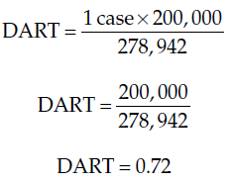
Calculating Days Away, Restricted, or Transfer (DART) Rates
Use only those injury cases (included in the TRIR) that resulted in days away, restricted, or transfer from job. The equation is as follows:
Example: As in the previous example, use 1 DART case and 278,942 total hours work to calculate the DART rate.

Slide 62


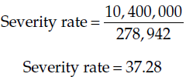
Calculating Severity Rates
To calculate the severity rates, use the following equation:
Example: Company XYZ had two recordable injuries with one of them resulting in 52 days of lost time. The total number of hours worked was 278,942 h.

Slide 63
Thank You
It is all about this chapter, for further study consult reference books and other online information source to enhance your knowledge against each individual concepts.

